Slide 1

V-Shaped Model
Learning Objectives :
Steps in the V-Shaped Model
The V-Shaped Model
V-Shaped Strengths
V-Shaped Weaknesses
Benefits of V-Model
The Capability Maturity Model (CMMI)

Slide 2
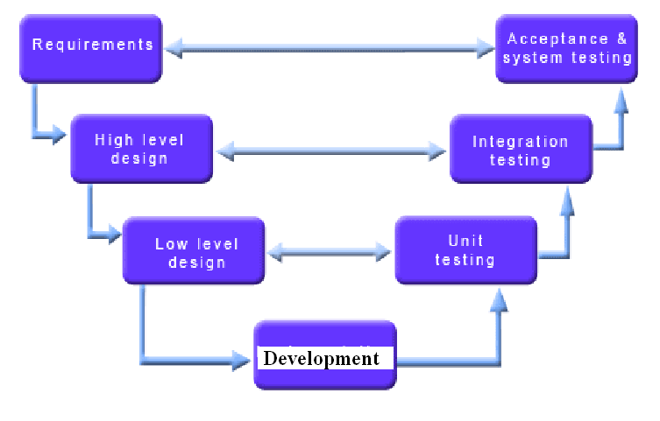
Steps in the V-Shaped
Model

Slide 3
The V-Shaped Model
V-Model evolved from waterfall Model.
Each phase must be completed before the next phase begins.
Instead of moving down in a linear way, the process steps are bent upwards after the coding phase, to form the typical V shape.
Testing is emphasized in this model more than in the waterfall model.
It is a structured approach to testing.
Brings high quality into the development of our products.

Slide 4
V-Shaped Strengths
Works well for small projects where requirements are easily understood.
Each phase has specific deliverables
Simple and Easy to use

Slide 5
V-Shaped Weaknesses
Very rigid like the waterfall model.
Software is developed during the developing phase, so no early prototypes of the software are produced.
Does not easily handle dynamic changes in requirements.
Does not contain risk analysis activities

Slide 6
Benefits of V-Model
Faults are prevented and it stops fault multiplication.
Avoids the downward flow of defect.
Lower defect Resolution cost due to earlier detection.
Improved quality and reliability.
Reduction in the amount of Re-work.
Validation at each level of stage containment.
Allows testers to be active in the project early in the project’s lifecycle. They develop critical knowledge about the system.

Slide 7

Explain different types of models ?
Explain the V model along with advantages and disadvantages.

Slide 8




